Slide 1
CS478 Computational Geometry Term Project
Implementing Three Voronoi Diagram Computation Algorithms and Comparing Their Performance
Alp Tuğrul Ağçalı Burak Öztürk

Slide 2
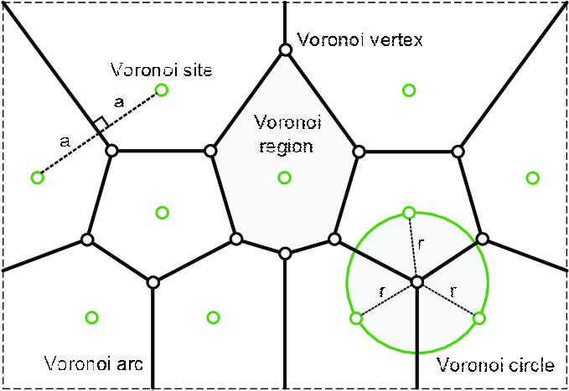
Voronoi Diagram
By definition, the Voronoi diagram is the division of a plane into n segments for a given n points. These n points are called Voronoi sites.
Regions formed after the partition represent the points which are closer to the site which belongs to this region than other sites.

Slide 3
Voronoi Diagram
According to this definition, the edge in the middle of the two sites is of equal length to both sites.
In addition, the Voronoi vertices are the center of the circumcircle of the sites of the three surrounding regions.

Slide 4
Implementing Three Voronoi Diagram Computation Algorithms and Comparing Their Performance
Randomized Incremental Algorithm
Fortune's Algorithm
The Flipping Algorithm

Slide 5
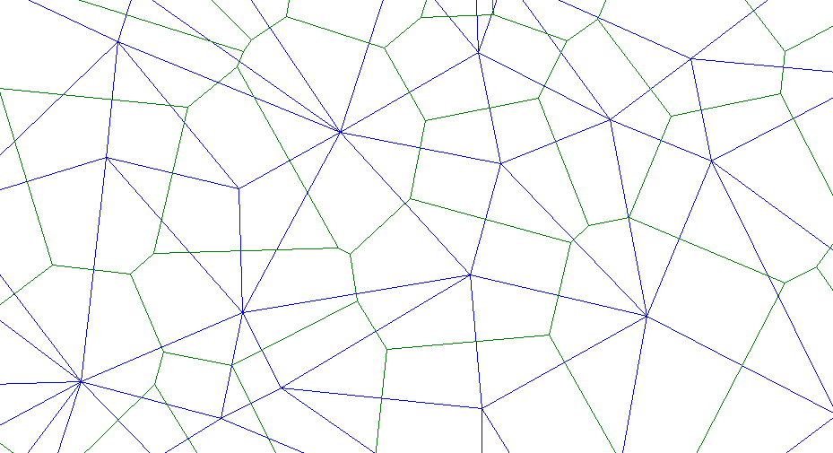
Randomized Incremental Algorithm
Randomized Incremental Algorithm is an algorithm that generates a Voronoi diagram from a set of points, theoretically using O(n log n) time and O(n) spaces.

Slide 6
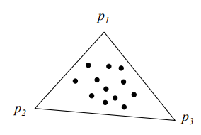
Randomized Incremental Algorithm
RIA starts by adding three points that form a triangle that encapsulates all other points.

Slide 7
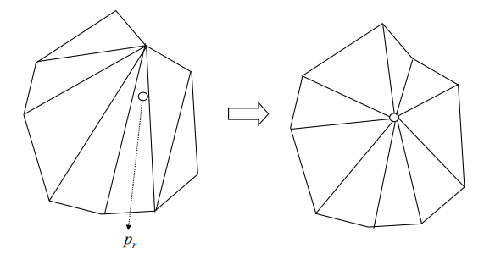
Randomized Incremental Algorithm
Then it adds points randomly to the triangulation by connecting it to the smallest triangle that contains it and corrects new edges to keep the Delaunay property.

Slide 8
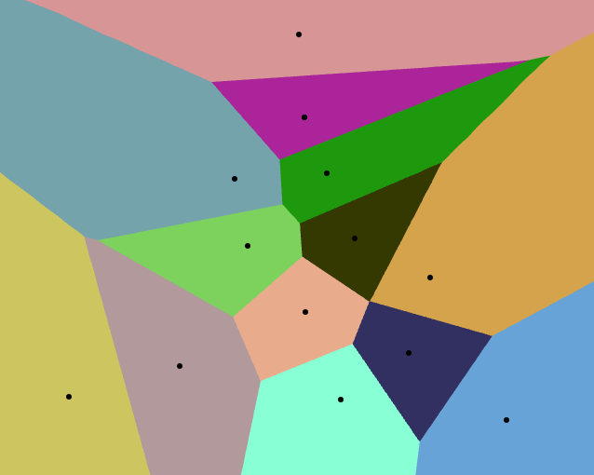
Randomized Incremental Algorithm
In the end, the result is the Delaunay Triangulation of the original set and it is converted to the dual Voronoi Diagram.
Circled points are the points added to encapsulate others. They will be removed for the final Voronoi diagram.

Slide 9
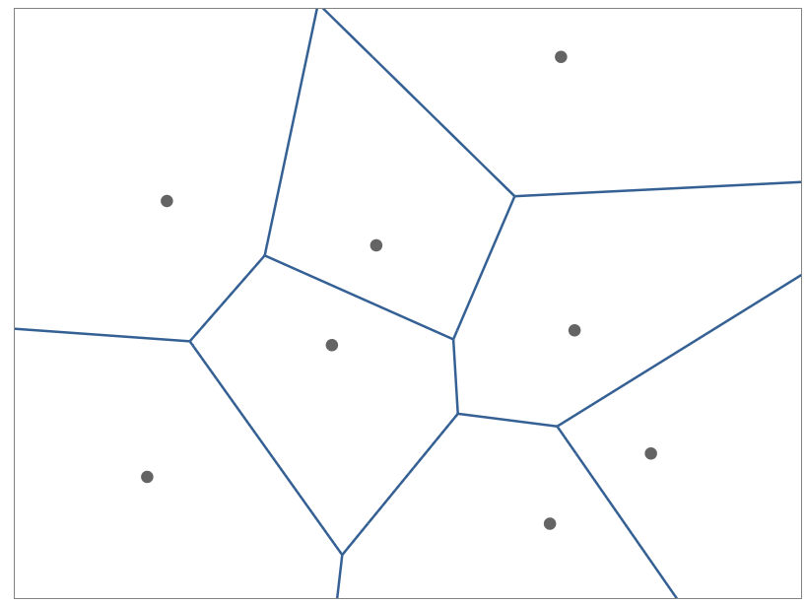
Fortune's Algorithm
Fortune's algorithm is an algorithm used to obtain a Voronoi diagram from a set of points, theoretically using O(n log n) time and O(n) spaces.

Slide 10
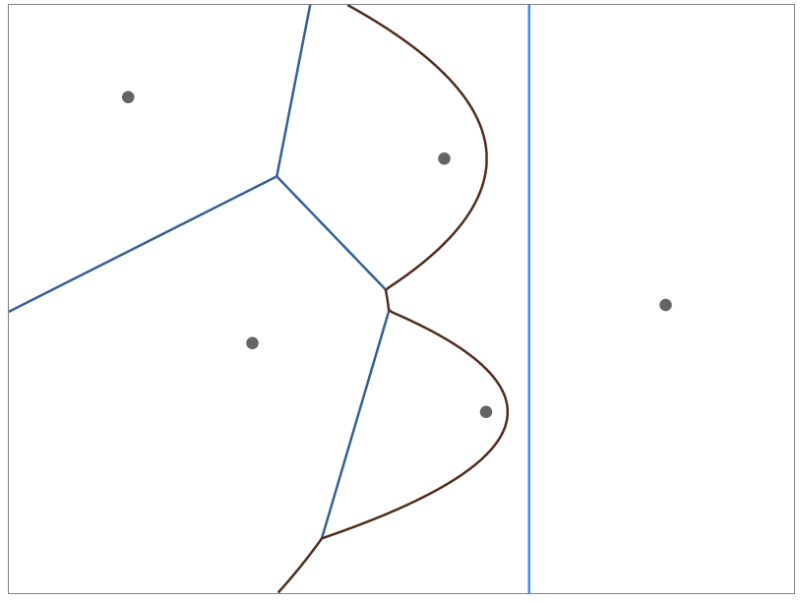
Fortune's Algorithm
The algorithm uses two different lines. One of them is called sweep line and the other is called beach line.
The beach line consists of a set of parabolic arcs. Each point on this arc is equidistant from the sweep line and the Voronoi site. The intersection points of the two arcs form the Voronoi edge.
Sweep line comes to each event in turn and computes that event.

Slide 11
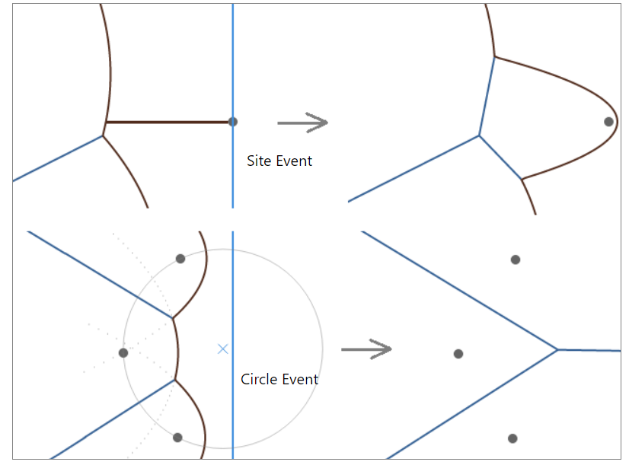
Fortune’s algorithm
Site Events
Site events are called handling Voronoi sites
When the Sweepline sees a site, it creates a parabolic arc that belongs to it.
After the new parabolic arc is formed, it is checked to see if there is a circle event ahead.

Slide 12
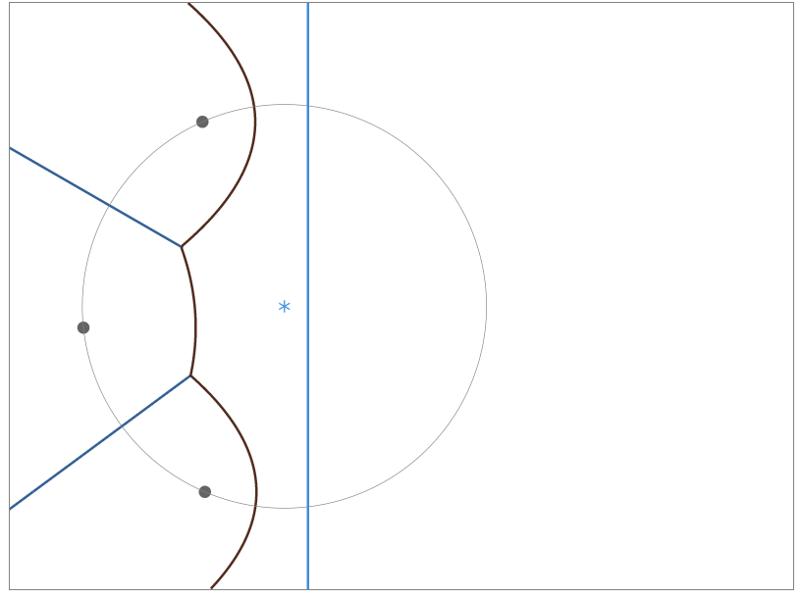
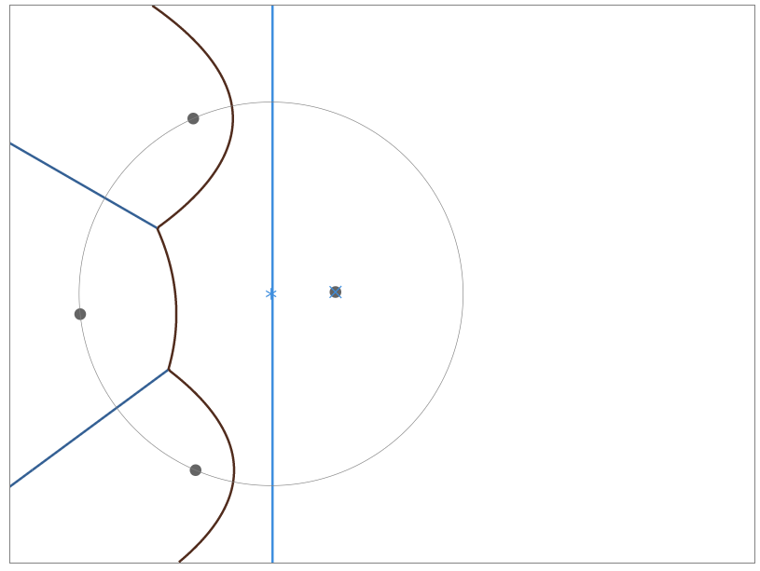
Fortune’s Algorithm
Circle Event
The circle event is called the center of the circumcircle of the site of the three arcs.
Each circle event is a potential Voronoi vertex.
If there is another site within the circumcircle, the center of the circumcircle is not a vertex. New circle events are found with the arc or arcs that occur with this new point.

Slide 13
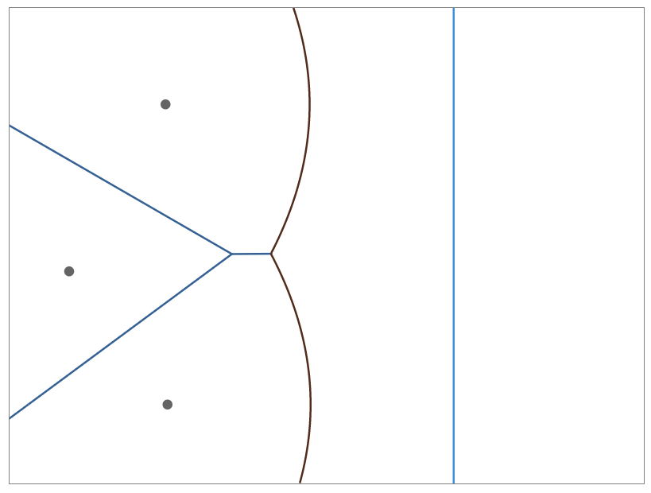
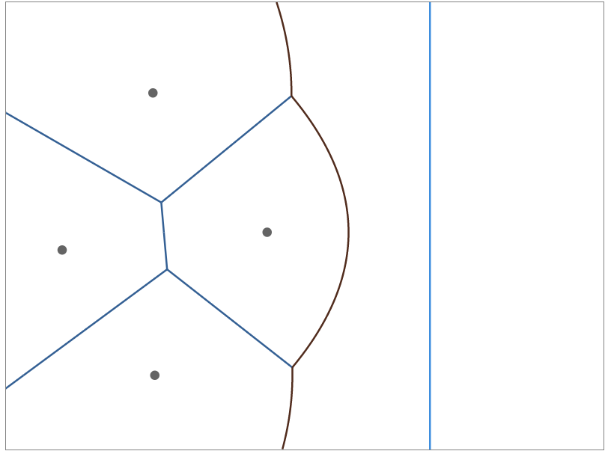
Fortune’s Algorithm

Slide 14
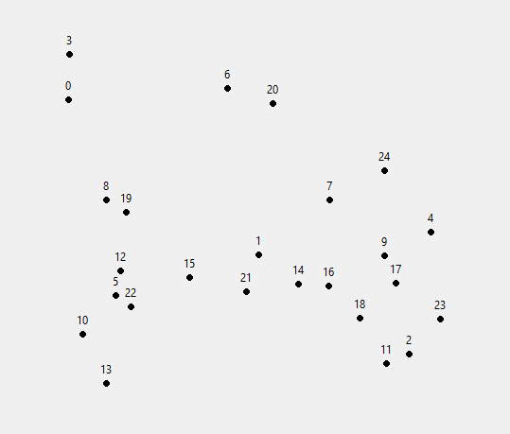
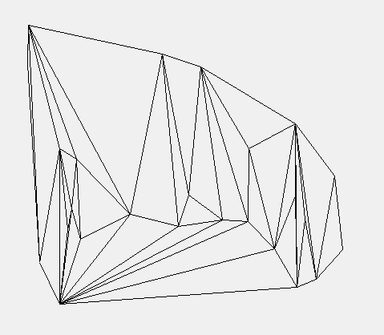
Flipping Algorithm
Flipping Algorithm is an algorithm that generates a Voronoi diagram from a set of points by converting any triangulation to the Delaunay Triangulation.

Slide 15
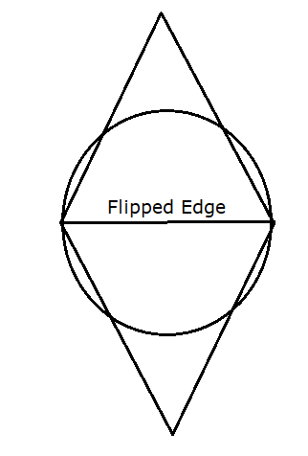
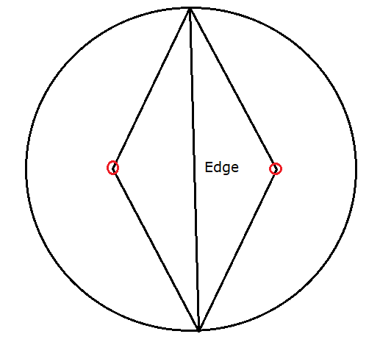
Flipping Algorithm
It converts any triangulation to a Delaunay Triangulation by flipping non-locally-Delaunay edges until no such edges are left.

Slide 16
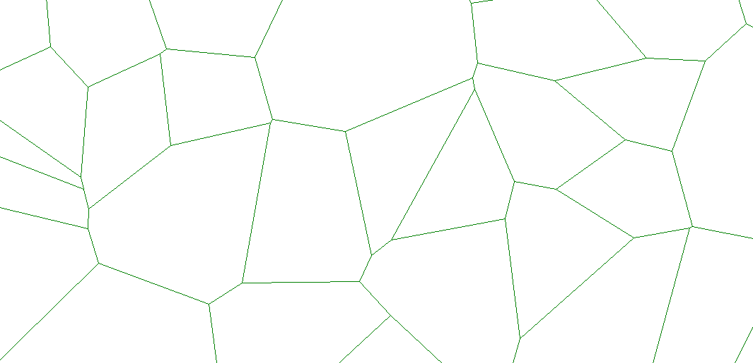
Flipping Algorithm
When all the flippings are done, remaining triangulation will be a Delaunay Triangulation and it can be converted to a Voronoi Diagram.

Slide 17
References
1. https://www.researchgate.net/figure/Voronoi-diagram-in-a-plane_fig1_325582898
2.http://www.eecs.tufts.edu/~vporok01/c163/
3. Course slides

